Slide 1
Insights into the Posey Database
Group 26

Slide 2
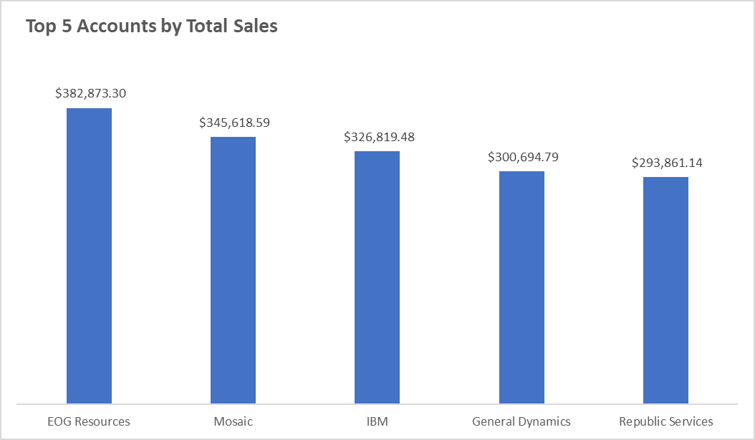

Slide 3
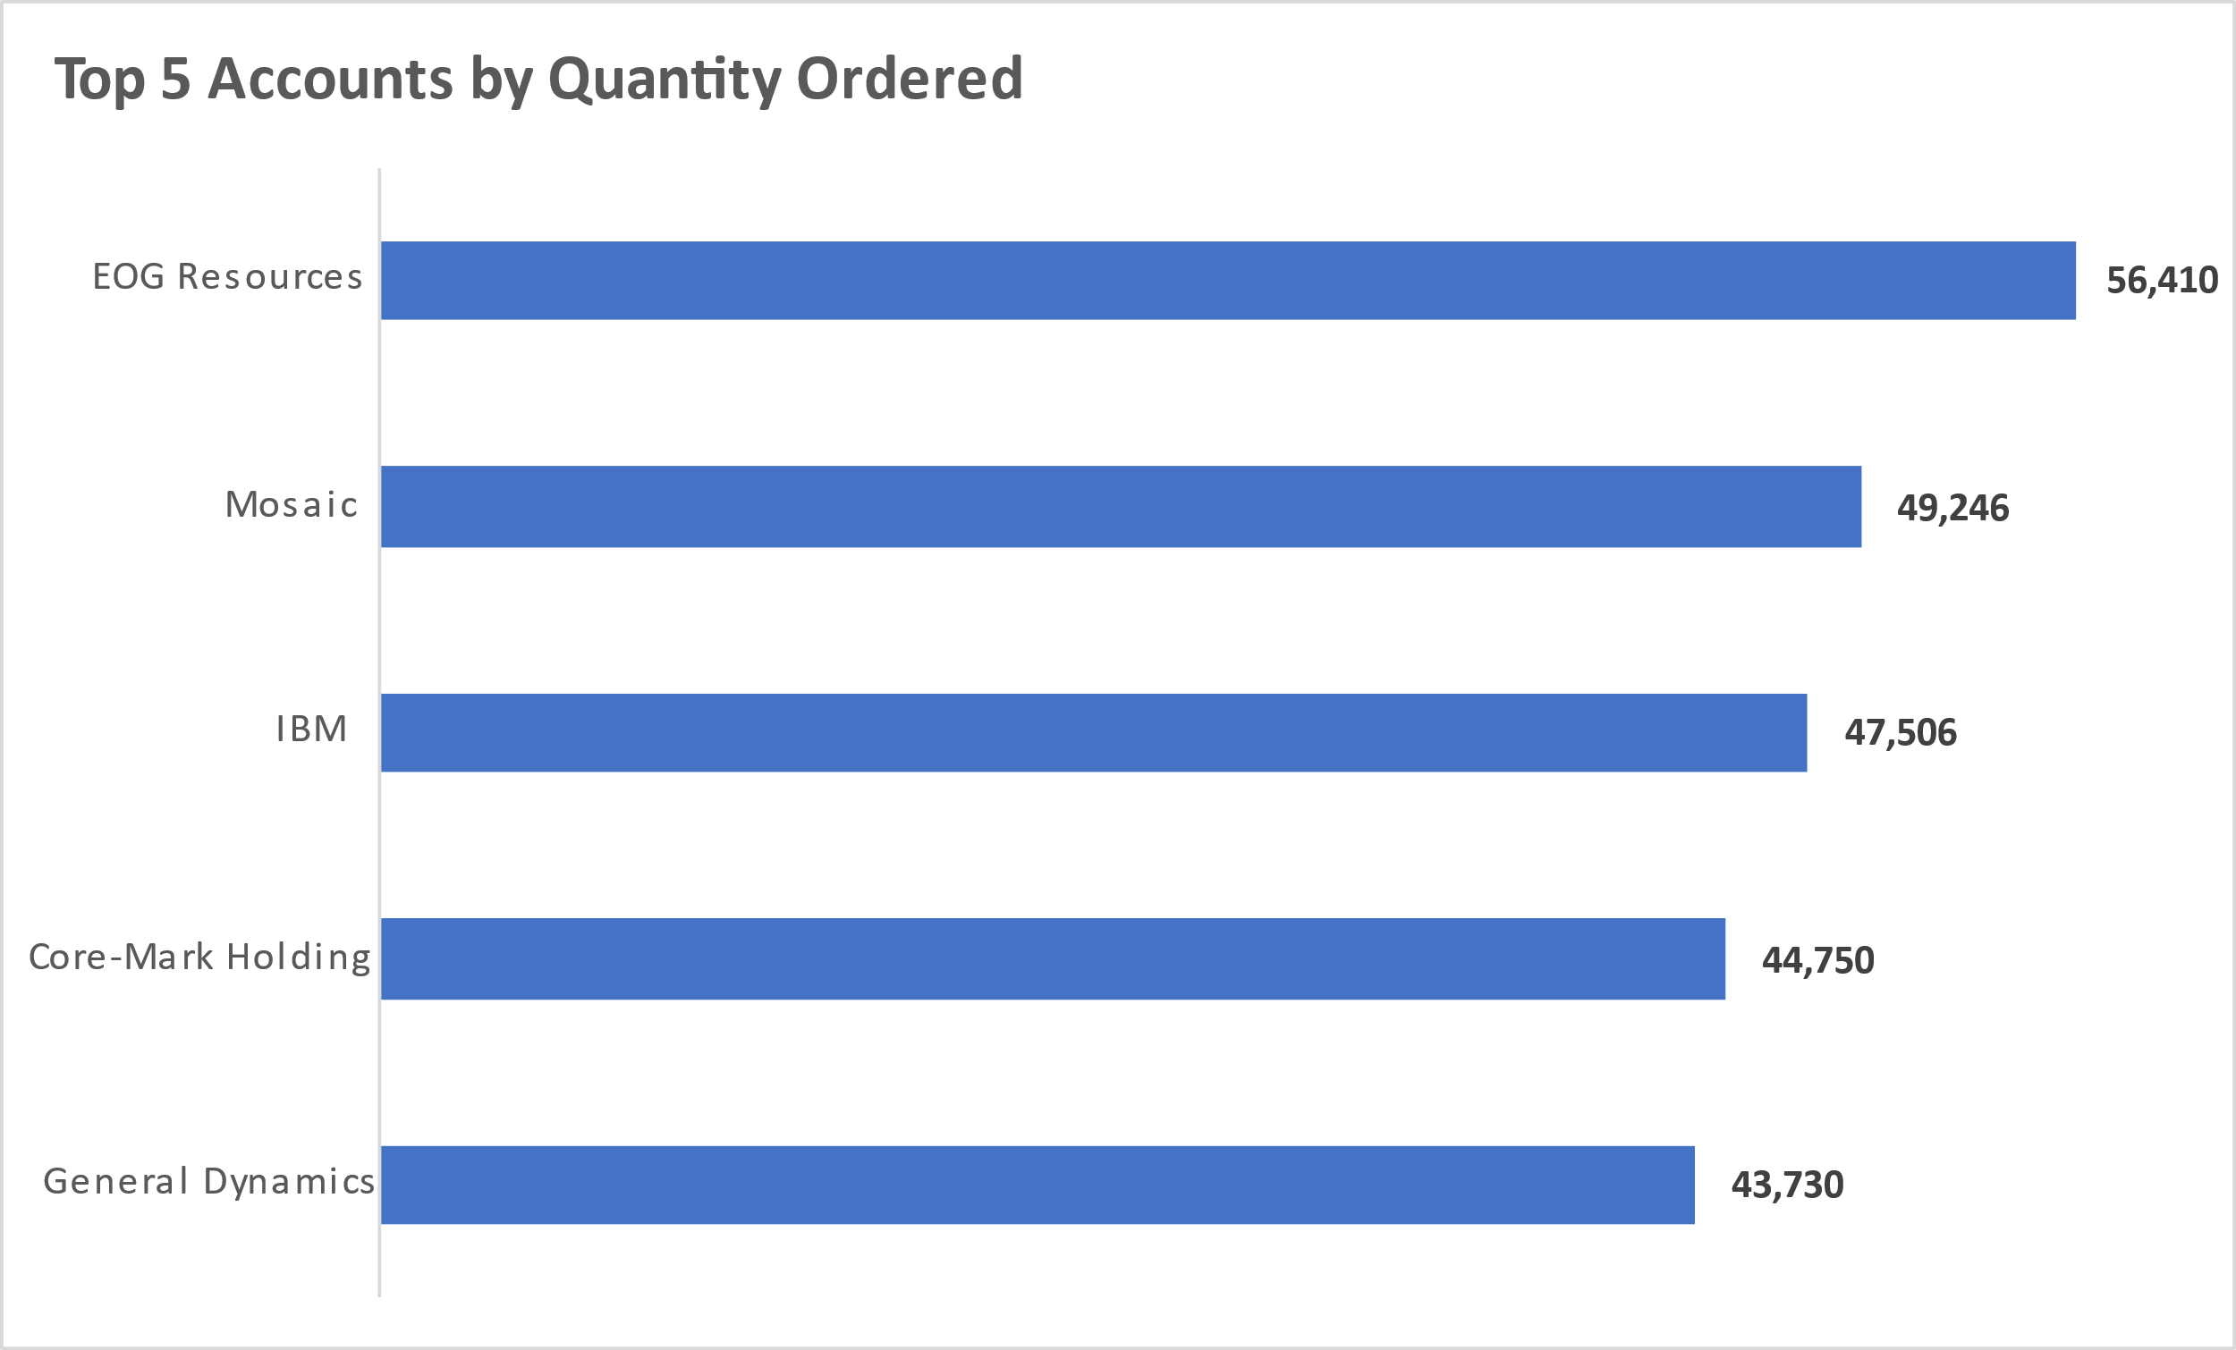

Slide 4
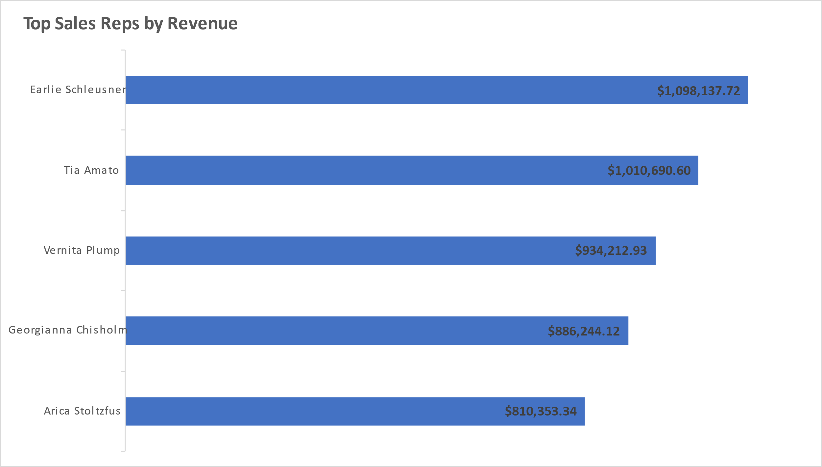

Slide 5
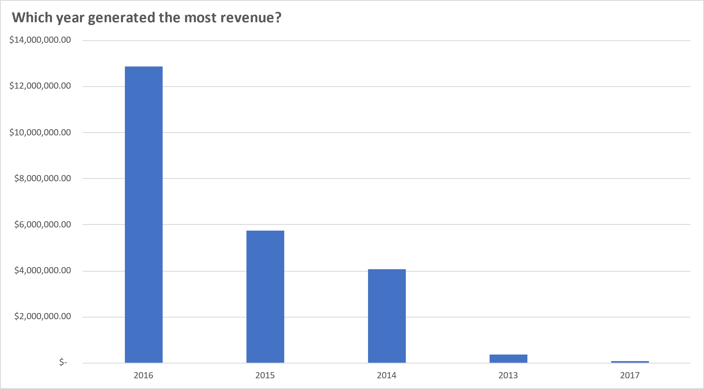

Slide 6
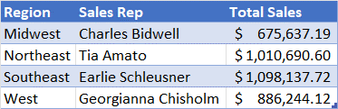
Who are the Top Sales Reps by Region?

Slide 7
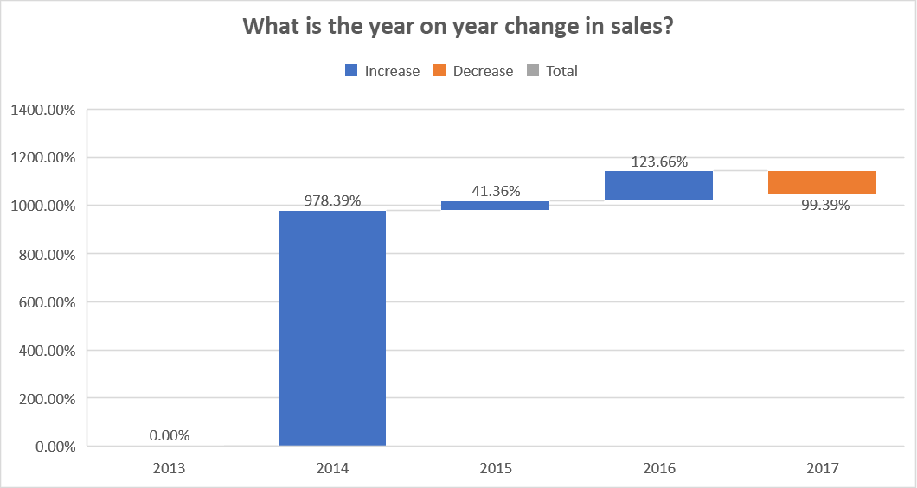

Slide 8
Group Members
Kenneth Imade - https://github.com/KenImade

